Slide 1


KARNAVATI UNIVERSITY
Unitedworld Institute of Technology
Coffee Shop Website
Web Technology
Semester: 6th
Programme: B. Tech CSE
Guided by:
Ms. Rama M. Maliya
Assistant Professor
UIT, KU
Prepared by:
Trushil Patel(20210702030)
B. Tech CSE

Slide 2

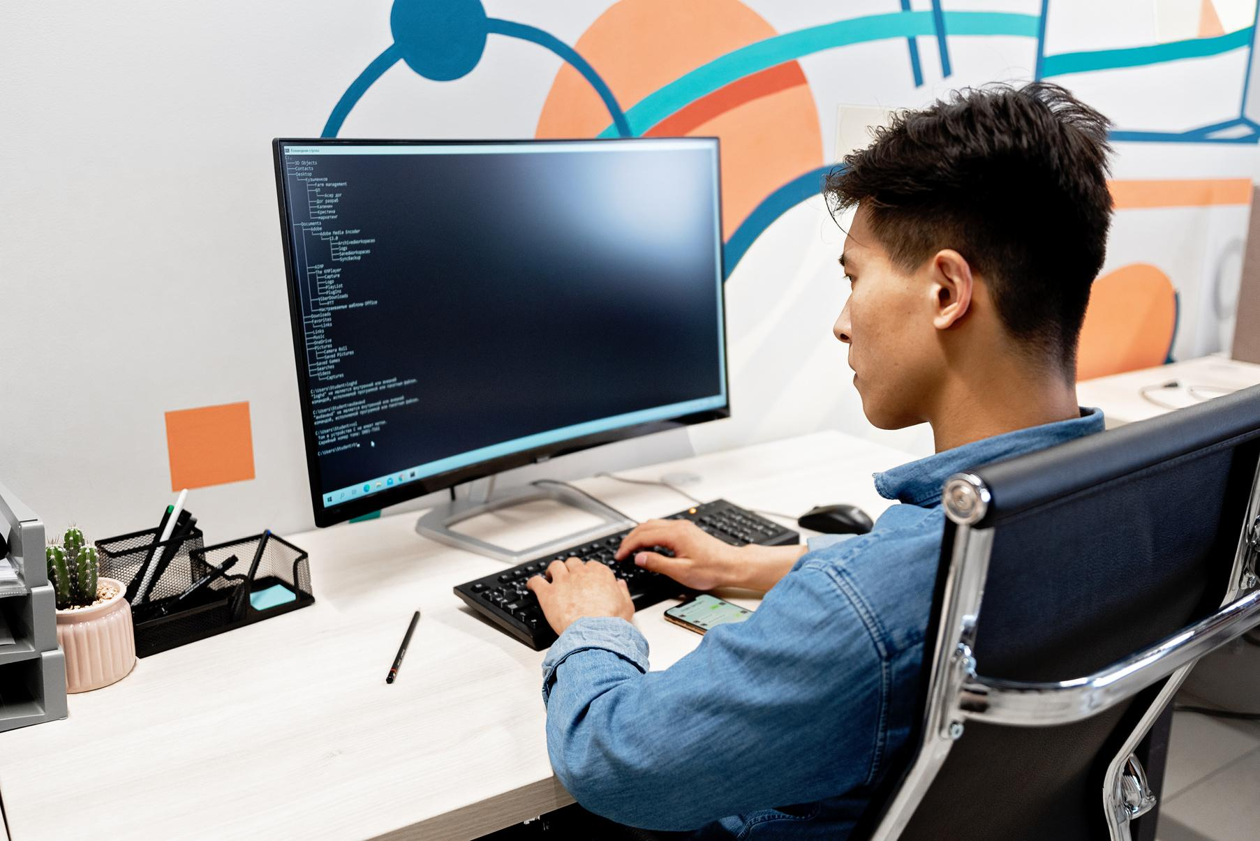


FRONT END
TECHNOLOGY
HTML
CSS
JavaScript
BACKEND
TECHNOLOGY
MySQL
php

Slide 3

PROJECT LINK
GitHub Link:
OR
Drive Link:

Slide 4

THANK YOU

